Slide 1

Consumer Behaviour Analysis
aVni Ahuja 229302287
Ananta TaneJa 229303233

Slide 2
PROBLEM STATEMENT
"Leveraging Big Data to Enhance Retail Marketing Strategies through Consumer Behavior Analysis"
Retailers today have access to vast amounts of consumer data, yet many struggle to effectively analyze and use this data to optimize marketing strategies. Traditional methods are often too broad and fail to address individual consumer preferences. With big data, there is a significant opportunity to gain deeper insights into consumer behavior, but the challenge lies in transforming that data into actionable strategies that can personalize customer experiences, improve targeting, and ultimately drive sales.
This project explores how big data can be used to better understand consumer behavior and improve retail marketing efforts, helping retailers make more informed decisions and achieve higher engagement and revenue.

Slide 3
Introduction
In today’s digital era, retailers have access to vast amounts of consumer data from multiple sources, including online transactions, social media, and customer interactions. However, turning this data into actionable insights remains a challenge for many businesses.
The goal of this project is to explore how big data analytics can be used to analyze consumer behavior and optimize retail marketing strategies. By understanding customer preferences and purchasing patterns, retailers can create personalized shopping experiences, improve customer targeting, and ultimately boost engagement and sales.
Through this project, we aim to design solutions that help retailers gain a competitive edge by transforming raw data into effective marketing strategies.

Slide 4
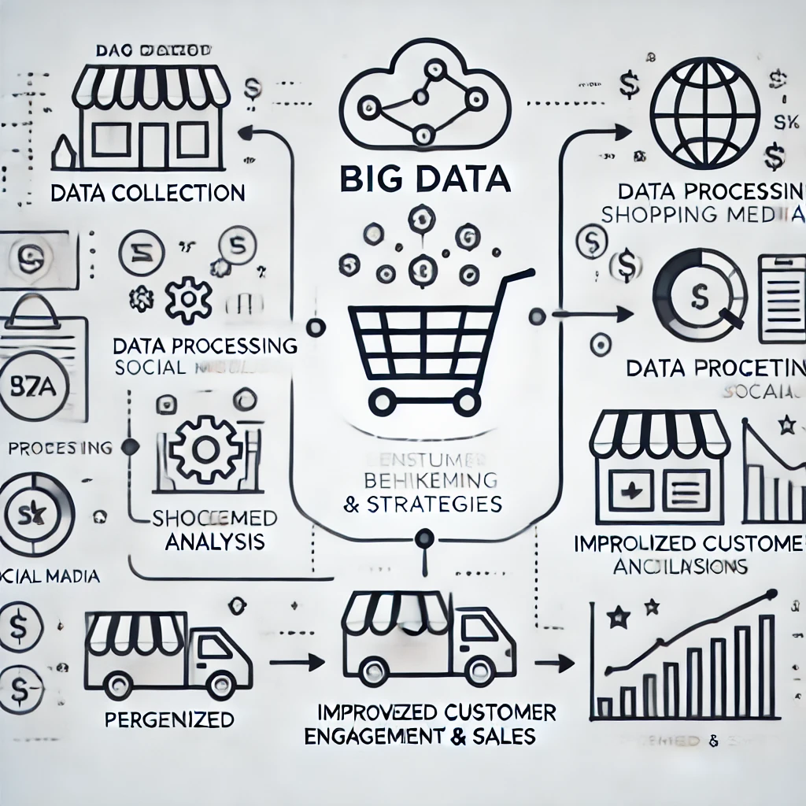
VISUAL REPRESENTATION OF HOW THE PROJECT WORKS

Slide 5
Flow of project
1. User access the website
2. Interface differences for consumers (browsing) and sellers (consultation)
3. Consumers can look at past patterns and input their purchasing habits in an analyzer to see if they have efficient shopping habits according to various factors.
4. Sellers can go to the specially curated interface for them to input their past data for personalized analysis and apply for consultation to devise foolproof marketing strategies according to the data put in by them.

Slide 6
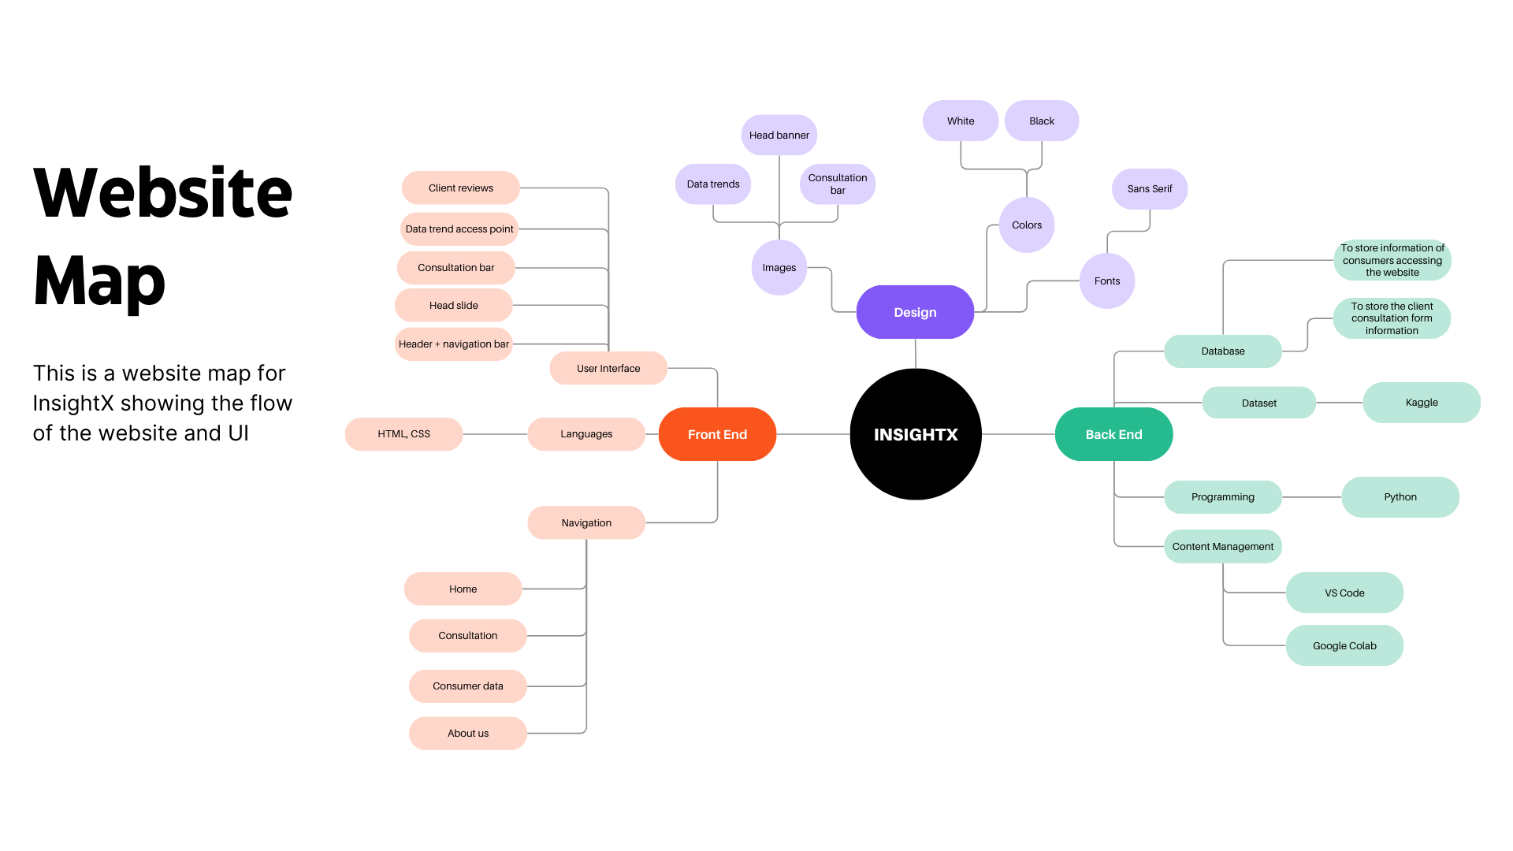

Slide 7
Chosen model: Unsupervised Learning
1. Define the Objective: Decide on the behaviour to predict, like purchase likelihood or churn.
2. Collect and Prepare Data: Gather consumer data (e.g., demographics, purchase history) and label it based on historical outcomes.
3. Feature Engineering: Extract relevant features, like recency and frequency of purchases.
4. Choose an Algorithm: Use models like logistic regression or random forests for classification, or linear regression for continuous predictions.
5. Train and Evaluate: Split data, train the model on one set, and evaluate its performance on another.
6. Interpret Results: Understand which features drive predictions and apply insights to make business decisions.
7. Deploy: Use predictions in real-time applications to enhance consumer engagement, reduce churn, or personalize marketing.

Slide 8
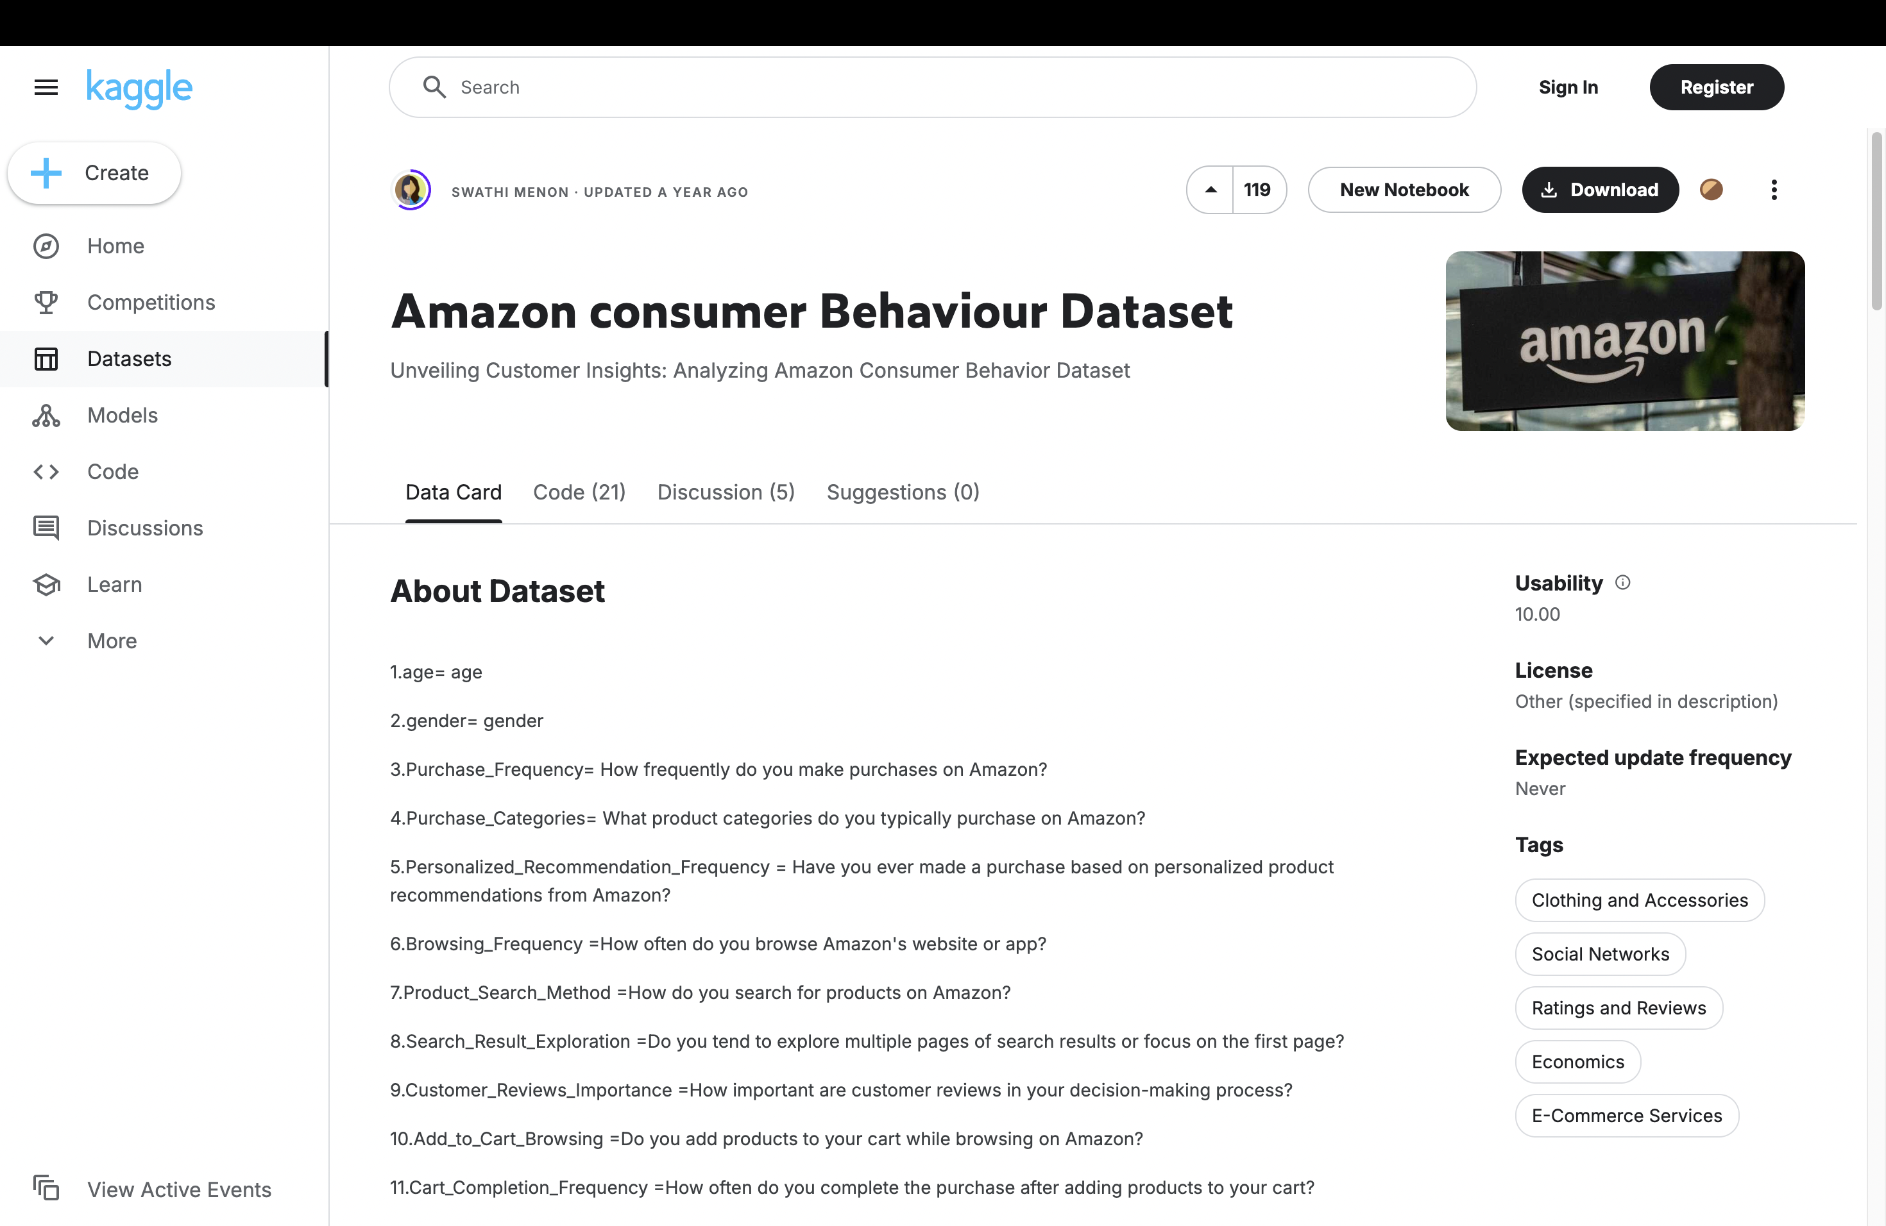
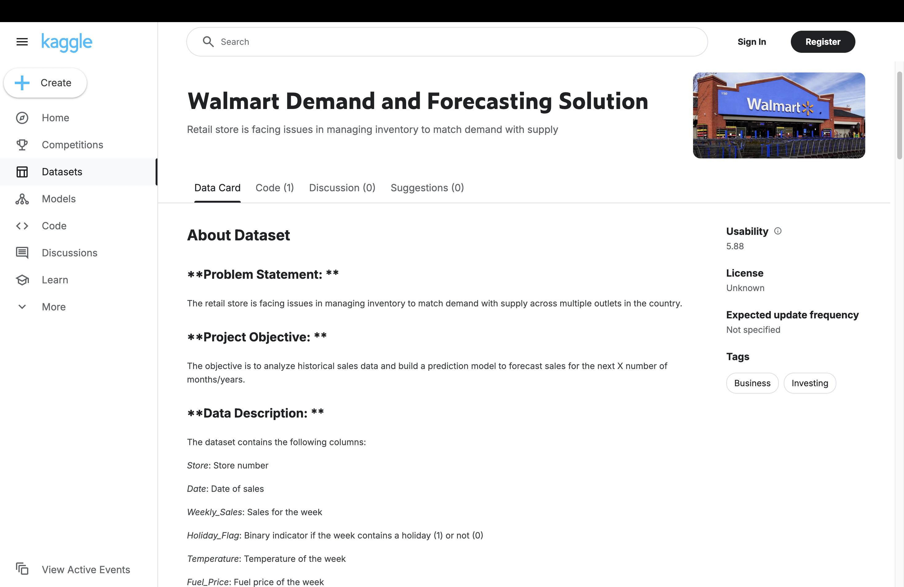
Datasets used

Slide 9
Web Scraping for Consumer Behavior Analysis
Web scraping was used to extract product data from various sites.
Data included product names, product prices, model variations, product descriptions, and product links.
Tools used: Selenium, WebScraper for automated data extraction.

Slide 10
Steps in Web Scraping
Create a Sitemap
Open Web Scraper in Developer Tools.
Click "Create new sitemap" and enter the website URL.
2. Define Selectors
Click Add new selector, name it, and choose the selector type (Text, Link, Image, Element).
Select elements from the webpage and save.
3. Set Up Pagination (if needed)
Create a pagination selector for "Next" buttons or page numbers.
Ensure it is nested under data selectors for seamless navigation.
4. Start Scraping
Click "Scrape" and set request limits/delays.
Web Scraper will extract data across pages.
5. Download Data
Go to "View Data" and export results as CSV or JSON.
Automated data collection across multiple pages and timestamps to track price fluctuations.

Slide 11
Analyzing Data for Market Trends
Price Trends: Observed fluctuations in prices of different brands over time.
Consumer Preferences: Analyzed which models were frequently bought based on reviews and ratings.
Competitor Pricing Strategy: Identified pricing patterns across brands to suggest better marketing strategies.

Slide 12
Market Insights from Web Scraping
Used Matplotlib & Seaborn to generate charts showing:
Price trends over time (line graph).
Popularity of different models (bar chart based on reviews).
Average rating vs. price comparison (scatter plot).

Slide 13
Using Web Scraped Data for Business Decisions
Dynamic Pricing Strategy: Adjust pricing based on competitors' fluctuations.
Targeted Marketing: Focus campaigns on trending and highly-rated products.
Product Positioning: Identify which models to promote based on customer interest.
Inventory Management: Predict demand based on price trends and sales fluctuations.

Slide 14
Thank you.

